Slide 1

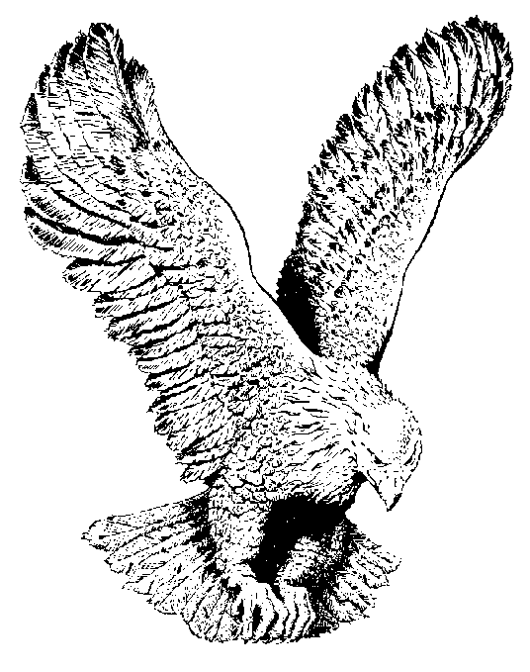
512 JESUS IS ALIVE
Jesus is alive, Jesus is alive.
Sin and death must go,
They are conquered foe,
For Jesus is alive.

